Slide 1
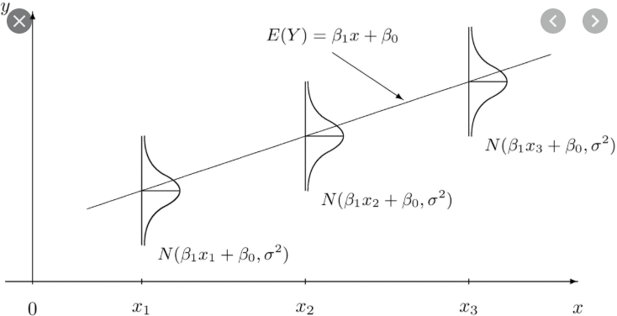
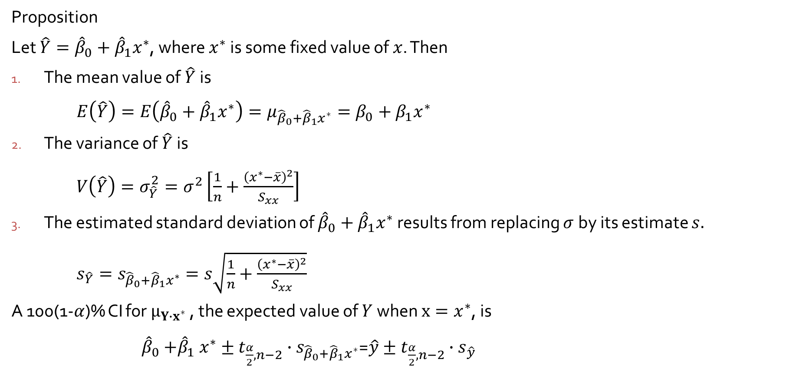
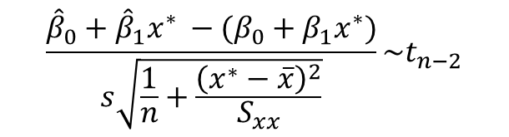
Inferences Concerning $μ_{Y∙x^{∗}}$ and the Prediction of Future $Y$ Values
Proposition
Let $\hat{Y}={\hat{β}}_{0}+{\hat{β}}_{1}x^{∗}$, where $x^{∗}$ is some fixed value of $x$. Then
The mean value of $\hat{Y}$is
$E\left(\hat{Y}\right)=E\left({\hat{β}}_{0}+{\hat{β}}_{1}x^{∗}\right)=μ_{{\hat{β}}_{0}+{\hat{β}}_{1}x^{∗}}=β_{0}+β_{1}x^{∗}$
The variance of $\hat{Y}$is
$V\left(\hat{Y}\right)=σ_{\hat{Y}}^{2}=σ^{2}\left[\frac{1}{n}+\frac{{\left(x^{∗}−\overline{x}\right)}^{2}}{S_{xx}}\right]$
The estimated standard deviation of ${\hat{β}}_{0}+{\hat{β}}_{1}x^{∗}$ results from replacing $σ$by its estimate $s.$
$s_{\hat{Y}}=s_{{\hat{β}}_{0}+{\hat{β}}_{1}x^{∗}}=s\sqrt{\frac{1}{n}+\frac{{\left(x^{∗}−\overline{x}\right)}^{2}}{S_{xx}}}$
A 100(1-$α$)% CI for $μ_{Y∙x^{∗}}$ , the expected value of $Y$when $x=x^{∗}$, is
${\hat{β}}_{0}{+\hat{β}}_{1}x^{∗}±t_{\frac{α}{2},n−2}∙s_{{\hat{β}}_{0}+{\hat{β}}_{1}x^{∗}}$=$\hat{y}±t_{\frac{α}{2},n−2}∙s_{\hat{y}}$
$$\frac{{\hat{β}}_{0}+{\hat{β}}_{1}x^{∗} −(β_{0}+β_{1}x^{∗})}{s\sqrt{\frac{1}{n}+\frac{{\left(x^{∗}−\overline{x}\right)}^{2}}{S_{xx}}}}\sim t_{n−2}$$

Slide 2
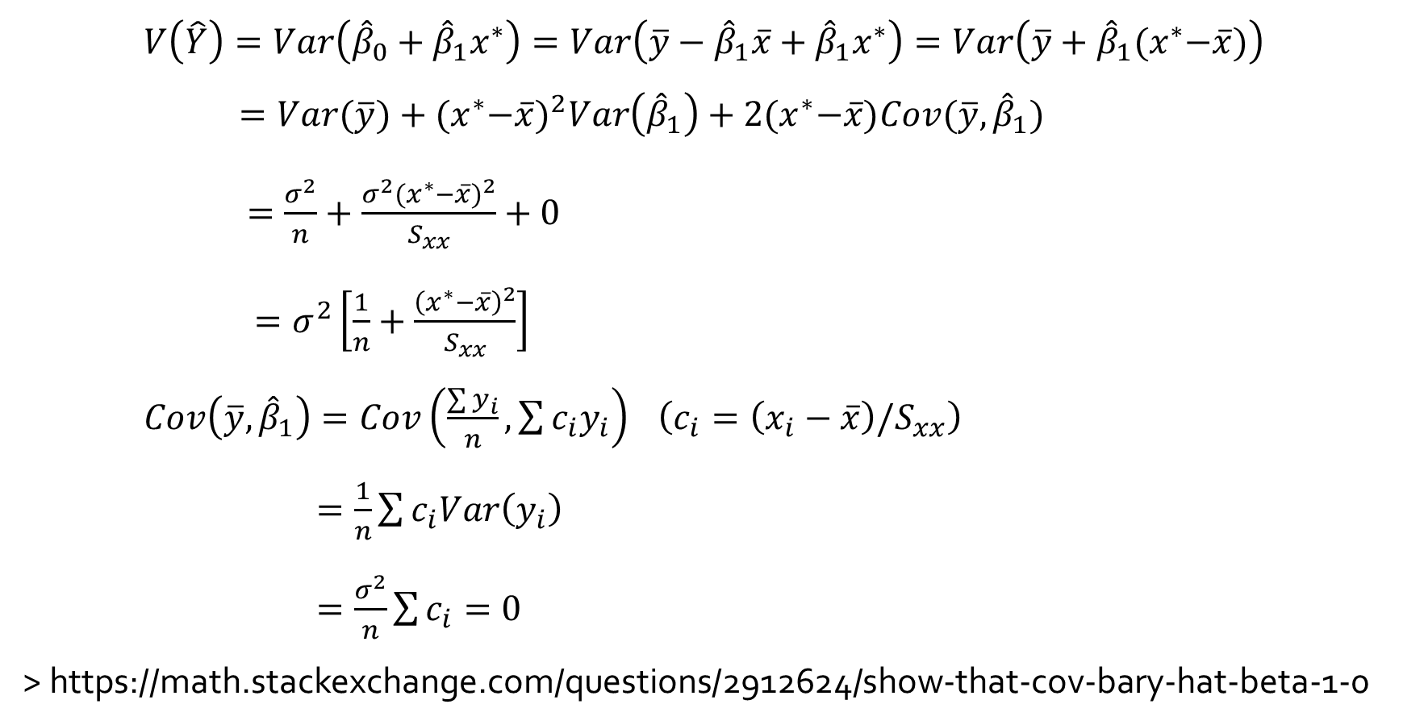
$V\left(\hat{Y}\right)=Var\left({\hat{β}}_{0}+{\hat{β}}_{1}x^{∗}\right)=Var\left(\overline{y}−{\hat{β}}_{1}\overline{x}+{\hat{β}}_{1}x^{∗}\right)=Var\left(\overline{y}+{\hat{β}}_{1}{(x}^{∗}−\overline{x})\right)$
$=Var(\overline{y})+{{(x}^{∗}−\overline{x})}^{2}Var\left({\hat{β}}_{1}\right)+2{(x}^{∗}−\overline{x})Cov(\overline{y}, {\hat{β}}_{1})$
$=\frac{σ^{2}}{n}+\frac{σ^{2}{{(x}^{∗}−\overline{x})}^{2}}{S_{xx}}+0$
$=σ^{2}\left[\frac{1}{n}+\frac{{\left(x^{∗}−\overline{x}\right)}^{2}}{S_{xx}}\right]$
$Cov\left(\overline{y}, {\hat{β}}_{1}\right)=Cov\left(\frac{\sum{y_{i}}}{n}, \sum{c_{i}y_{i}}\right)$ $\left(c_{i}=\left(x_{i}−\overline{x}\right)/S_{xx}\right)$
$=\frac{1}{n}\sum{c_{i}Var\left(y_{i}\right)}$
$=\frac{σ^{2}}{n}\sum{c_{i}=0}$
> https://math.stackexchange.com/questions/2912624/show-that-cov-bary-hat-beta-1-0

Slide 3
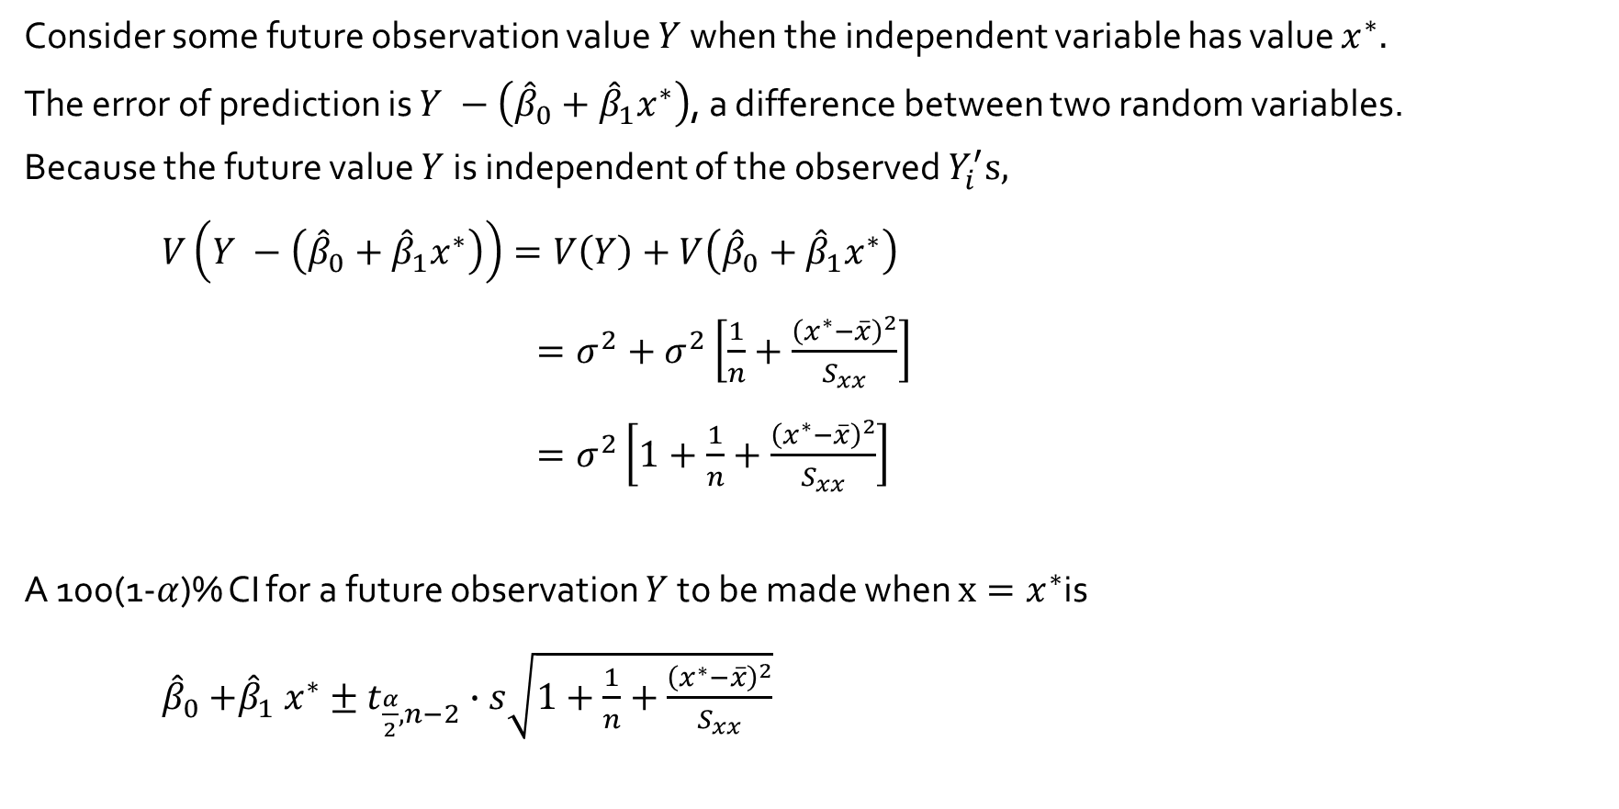
A Prediction Interval of Future $Y$ Values
Consider some future observation value $Y$when the independent variable has value $x^{∗}.$
The error of prediction is $Y −\left({\hat{β}}_{0}+{\hat{β}}_{1}x^{∗}\right)$, a difference between two random variables.
Because the future value $Y$is independent of the observed $Y_{i}^{′}s,$
$V\left(Y −\left({\hat{β}}_{0}+{\hat{β}}_{1}x^{∗}\right)\right)=V\left(Y\right)+V\left({\hat{β}}_{0}+{\hat{β}}_{1}x^{∗}\right)$
$=σ^{2}+σ^{2}\left[\frac{1}{n}+\frac{{\left(x^{∗}−\overline{x}\right)}^{2}}{S_{xx}}\right]$
$=σ^{2}\left[1+\frac{1}{n}+\frac{{\left(x^{∗}−\overline{x}\right)}^{2}}{S_{xx}}\right]$
A 100(1-$α$)% CI for a future observation $Y$to be made when $x=x^{∗}$is
${\hat{β}}_{0}{+\hat{β}}_{1}x^{∗}±t_{\frac{α}{2},n−2}∙s\sqrt{1+\frac{1}{n}+\frac{{\left(x^{∗}−\overline{x}\right)}^{2}}{S_{xx}}}$

Slide 4
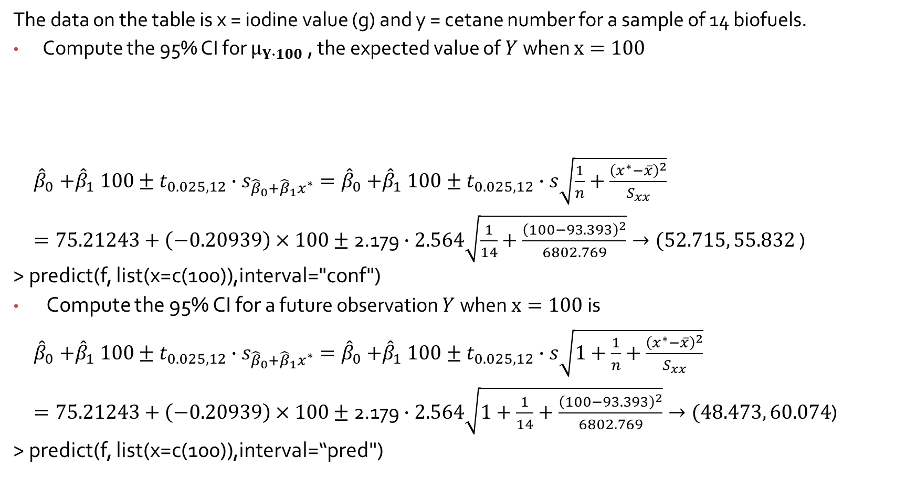
Example
The data on the table is x = iodine value (g) and y = cetane number for a sample of 14 biofuels.
Compute the 95% CI for $μ_{Y∙100}$ , the expected value of $Y$when $x=100$
${\hat{β}}_{0}{+\hat{β}}_{1}100±t_{0.025, 12}∙s_{{\hat{β}}_{0}+{\hat{β}}_{1}x^{∗}}={\hat{β}}_{0}{+\hat{β}}_{1}100±t_{0.025, 12}∙s\sqrt{\frac{1}{n}+\frac{{\left(x^{∗}−\overline{x}\right)}^{2}}{S_{xx}}}$
$=75.21243+\left(−0.20939\right)×100±\text{2.179}∙2.564\sqrt{\frac{1}{14}+\frac{{\left(100−93.393\right)}^{2}}{6802.769}}→(52.715, 55.832$ )
> predict(f, list(x=c(100)),interval="conf")
Compute the 95% CI for a future observation $Y$when $x=100$is
${\hat{β}}_{0}{+\hat{β}}_{1}100±t_{0.025, 12}∙s_{{\hat{β}}_{0}+{\hat{β}}_{1}x^{∗}}={\hat{β}}_{0}{+\hat{β}}_{1}100±t_{0.025, 12}∙s\sqrt{1+\frac{1}{n}+\frac{{\left(x^{∗}−\overline{x}\right)}^{2}}{S_{xx}}}$
$=75.21243+\left(−0.20939\right)×100±\text{2.179}∙2.564\sqrt{1+\frac{1}{14}+\frac{{\left(100−93.393\right)}^{2}}{6802.769}}→(48.473, 60.074$)
> predict(f, list(x=c(100)),interval=“pred")
x | 132.0 129.0 120.0 113.2 105.0 92.0 84.0 83.2 88.4 59.0 80.0 81.5 71.0 69.2
y | 46.0 48.0 51.0 52.1 54.0 52.0 59.0 58.7 61.6 64.0 61.4 54.6 58.8 58.0

